Slide 1

Political impacts
Nemuulen.T 11C

Slide 2
Internal migration at a significant scale can have considerable political repercussions. For example:
Where migration results in depopulation → decreased funding from central government
Where population is growing rapidly → dominant political and economic role, but detriment to the rest of that country.
Change the ethnic composition → tension

Slide 3
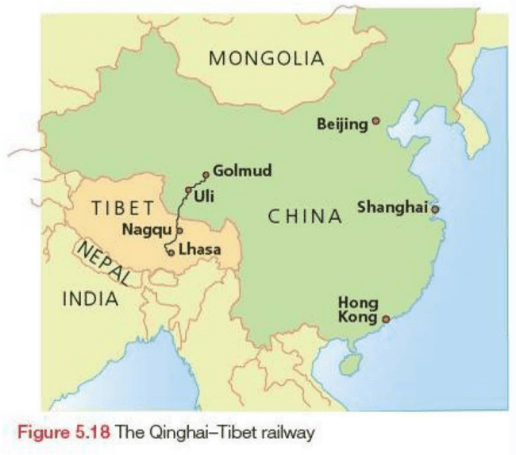



Case study:
Tibet’s changing ethnic balance
Tibet is an example where the in-migration of large numbers of Han Chinese has had a huge impact.
Chinese occupation of Tibet in 1950
In the capital city, Lhasa, there are 200000 Chinese and 100000 Tibetans.
Han Chinese:
government officials and technical experts who can be thought of as involuntary migrants
economic migrants - miners, construction workers, retail and other service workers.

Slide 4

The Dalai Lama, Tibet's exiled spiritual leader, has stated that this policy of demographic aggression has led to 'cultural genocide’.

Slide 5


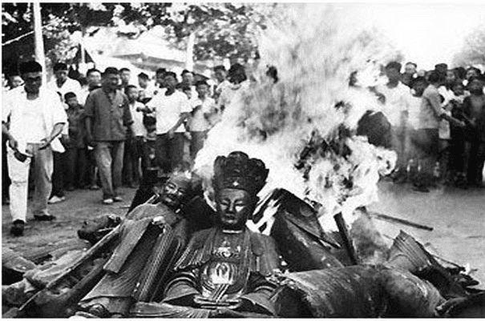
Since 1949 the Chinese government has used the minority-education system for Tibetans to acquire the Chinese language, considered a key tool of Sinicization pressure.
The Chinese government claims it will control how the 15th Dalai Lama will be chosen, contrary to centuries of tradition.
EDUCATION
POPULATION
RELIGION
Forced abortion, sterilization of Tibetan women and the transfer of low income Chinese citizens threaten the survival of Tibet's unique culture.

Slide 6
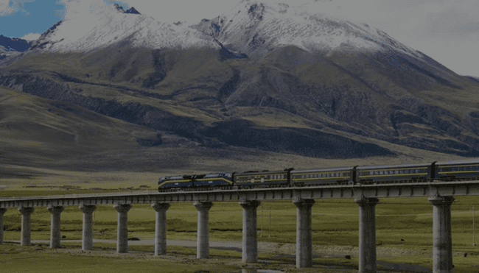
Qinghai - Tibet line
In 2006, the world's highest railway, the Qinghai - Tibet line, was opened. It runs from Golmud to Lhasa (Figure 5.18). China says the 1140 kilometre line will bring economic opportunities to Tibet. However, many Tibetans fear it will encourage even more in-migration.

Slide 7

Environmental impact
tension
Batzolboo.T 11D

Slide 8
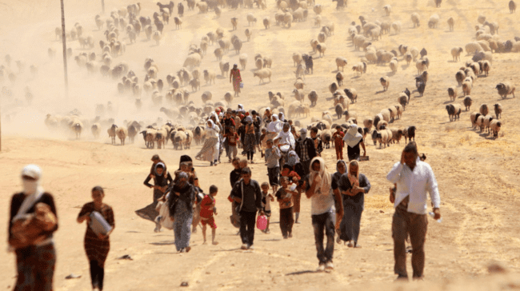
Causes of environmental migration
Floods
Desertification
Other environmental effects

Slide 9
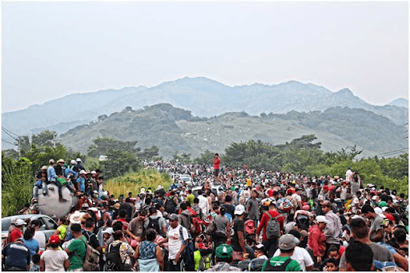
Impacts of environmental migration
Internally displaced people often concentrate in marginal and vulnerable environments where the potential for environmental degradation is high. Apart from immediate problems concerning sanitation and the disposal of waste, long-term environmental damage may result from deforestation associated with the need for firewood and building materials. Increased pressure on the land can result in serious soil degradation.

Slide 10

A study of high in-migration into the coastal areas of Palawan in the Philippines found that the historical social processes that helped maintain reasonable patterns of environmental use had been overwhelmed by the rapid influx of migrants. The newcomers brought in new resource extraction techniques that were more efficient but also more destructive than those previously employed by the established community. The study concluded that high in-migration had caused severe environmental damage to the coastal environment.

